Slide 1
Chapter 1
Overview of Databases and Transaction Processing

Slide 2
What is a Database?
Collection of data central to some enterprise
Essential to operation of enterprise
Contains the only record of enterprise activity
An asset in its own right
Historical data can guide enterprise strategy
Of interest to other enterprises
State of database mirrors state of enterprise
Database is persistent

Slide 3
What is a Database Management System?
A Database Management System (DBMS) is a program that manages a database:
Supports a high-level access language (e.g. SQL).
Application describes database accesses using that language.
DBMS interprets statements of language to perform requested database access.

Slide 4
Database products
Oracle (https://www.oracle.com/database/index.html)
MySQL https://www.mysql.com/
Microsoft SQL server (http://www.microsoft.com/en-us/server-cloud/products/sql-server/)
SAP HANA (www.sap.com)

Slide 5
What is a Transaction?
When an event in the real world changes the state of the enterprise, a transaction is executed to cause the corresponding change in the database state
With an on-line database, the event causes the transaction to be executed in real time
A transaction is an application program with special properties - discussed later - to guarantee it maintains database correctness

Slide 6
What is a Transaction Processing System?
Transaction execution is controlled by a TP monitor
Creates the abstraction of a transaction, analogous to the way an operating system creates the abstraction of a process
TP monitor and DBMS together guarantee the special properties of transactions
A Transaction Processing System consists of TP monitor, databases, and transactions

Slide 7
Transaction Processing System
DBMS
database
transactions
DBMS
database
TP Monitor

Slide 8
System Requirements
High Availability: on-line => must be operational while enterprise is functioning
High Reliability: correctly tracks state, does not lose data, controlled concurrency
High Throughput: many users => many transactions/sec
Low Response Time: on-line => users are waiting

Slide 9
System Requirements (con’t)
Long Lifetime: complex systems are not easily replaced
Must be designed so they can be easily extended as the needs of the enterprise change
Security: sensitive information must be carefully protected since system is accessible to many users
Authentication, authorization, encryption

Slide 10
Roles in Design, Implementation, and Maintenance of a TPS
System Analyst - specifies system using input from customer; provides complete description of functionality from customer’s and user’s point of view
Data Scientists: use all available data sources (internal and external) to analyze and gain insights to help decision makers.
Database Designer - specifies structure of data that will be stored in database.

Slide 11
Roles in Design, Implementation and Maintenance of a TPS (con’t)
Application Programmer - implements application programs (transactions) that access data and support enterprise rules
Database Administrator - maintains database once system is operational: space allocation, performance optimization, database security
System Administrator - maintains transaction processing system: monitors interconnection of HW and SW modules, deals with failures and congestion

Slide 12
OLTP vs. OLAP
On-line Transaction Processing (OLTP)
Day-to-day handling of transactions that result from enterprise operation
Maintains correspondence between database state and enterprise state
On-line Analytic Processing (OLAP)
Analysis of information in a database for the purpose of making management decisions

Slide 13
OLAP
Analyzes historical data (terabytes) using complex queries
Due to volume of data and complexity of queries, OLAP often uses a data warehouse
Data Warehouse - (offline) repository of historical data generated from OLTP or other sources
Data Mining - use of warehouse data to discover relationships that might influence enterprise strategy

Slide 14
Examples - Supermarket
OLTP
Event is 3 cans of soup and 1 box of crackers bought; update database to reflect that event
OLAP
Last winter in all stores in northeast, how many customers bought soup and crackers together?
Data Mining
Are there any interesting combinations of foods that customers frequently bought together?

Slide 15
Big Data Era
Every 2 days we create as much information as we did from the dawn of civilization up to 2003. (2010, Eric Shmidt, Google)
Science: Astronomy, Physics, Bioinformatics, Neuroinfomatics, earth science, etc.
Business: Automobile, Healthcare, Financial, infotaiment
The automotive industry will likely become the 2nd largest generator of data in the near future.

Slide 16
Big Data Opportunities to Auto
Google self-driving car (generates 1GB/s).
Recommendation/alert to customers.
Manufactures can better understand customers and market trends.
Better driving behaviors, better cars, less accidents, and the bottom line is happier customers.

Slide 17
Big Data Opportunities to Auto
Google self-driving car (generates 1GB/s).
Recommendation/alert to customers.
Manufactures can better understand customers and market trends.
Better driving behaviors, better cars, less accidents, and the bottom line is happier customers.

Slide 18


Why is Database Important in the Future?
“In the future, … any given discipline advances is likely to depend on… database, workflow management, visualization, and cloud computing technologies. “
G. Bell, T. Hey, A. Szalay, “Beyond the Data Deluge,” Science, Vol. 323, no. 5919, pp. 1297-1298, 2009.

Slide 19
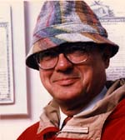
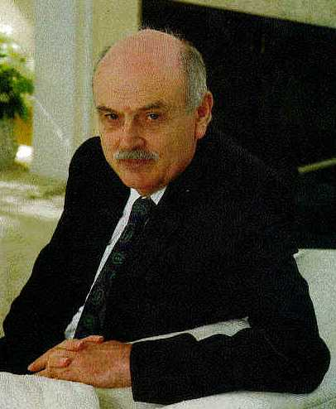


Turing Awardees in DB
Charles Bachman (1973)
Edgar F. Codd (1981)
Jim Gray (1998)
Michael Stonebraker (2014)

Slide 20

Charles Bachman
Developer of IDS: the first database system

Slide 21

Edgar. F. Codd
Inventor of the Relational Model

Slide 22
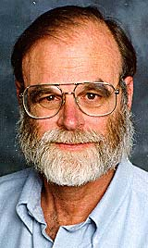
Jim Gray
Founder of Transaction Processing

Slide 23
Michael Stonebraker
Inventor of Ingres and Postgres

Slide 24
Exercise 1
Download Java JDK at http://www.oracle.com/technetwork/java/javase/downloads/index.html
Try the first Java program (test1.java at blackboard in Blackboard/Content tab)
java -cp .;lib\classes12.zip;lib\mysql-connector-java-5.1.32-bin.jar test1

Slide 25
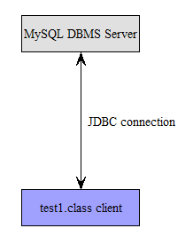
Exercise 1 Illustration
You do not need to download MySQL for Exercise 1, use the server specified in test1.java. Run exercise 1 on campus.

Slide 26
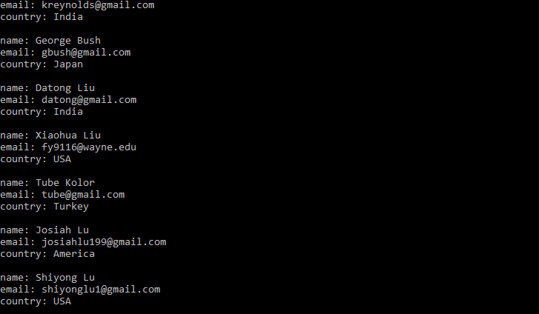
Exercise 1 output

Slide 27
Exercise 2 (connect to your own mysql)
Download and install mysql from www.mysql.com
Create your own database and table locally
Change test1.java line
jdbc:mysql://127.0.0.1:3306/test?” + "user=shiyong&password=view1234”
Run test1.java that connects to a local mysql server in your pc.

Slide 28
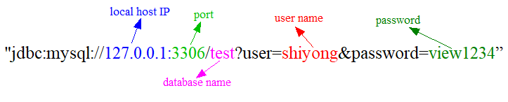
How to connect to MySQL in Java

Slide 29
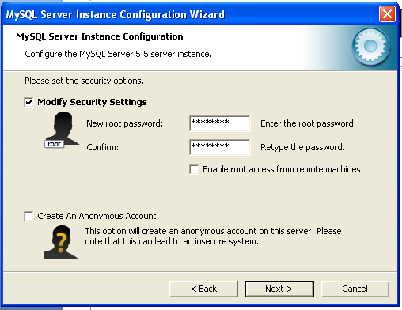
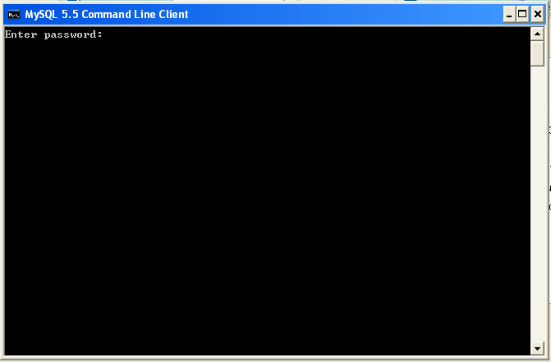
Download Mysql
www.mysql.com
Keep the password after setting a new root password, which will be the one you are asked to enter each time Mysql is launched.

Slide 30
Download Mysql
Download the MySQL Community Server 5.7.19 from http://dev.mysql.com/downloads/mysql/
by selecting the right OS platform
A youtube for installing mysql: https://www.youtube.com/watch?v=iOlJxOkp6sI&spfreload=10. or https://www.youtube.com/watch?v=WuBcTJnIuzo
Remember the password.
You can use mysql workbench to manage your connection. http://dev.mysql.com/downloads/workbench/.

Slide 31
Download Mysql for Windows
You can download the windows version from the below website: https://dev.mysql.com/downloads/installer/.
You can download the .msi file and double click to run the installation process.

Slide 32
Try Example 1
show databases;
CREATE database test;
use test;
CREATE TABLE member ( name varchar(50),
email varchar(100),
country varchar(50), PRIMARY KEY (name));
INSERT INTO member VALUES ('Smith‘, ‘smith@gmail.com’, ‘USA’);
SELECT * from member;

Slide 33
Try Example 2
CREATE TABLE employee ( empID int(11) NOT NULL AUTO_INCREMENT, firstName varchar(100) DEFAULT NULL, PRIMARY KEY (empID));
INSERT INTO employee( firstName) VALUES ('Smith');
SELECT * from employee;

Slide 34
Some Notes
Always end with ‘;’
If a column name is repeated, you can get an error message.
Mysql codes are not case sensitive, but the values in any quotation marks are.

Slide 35
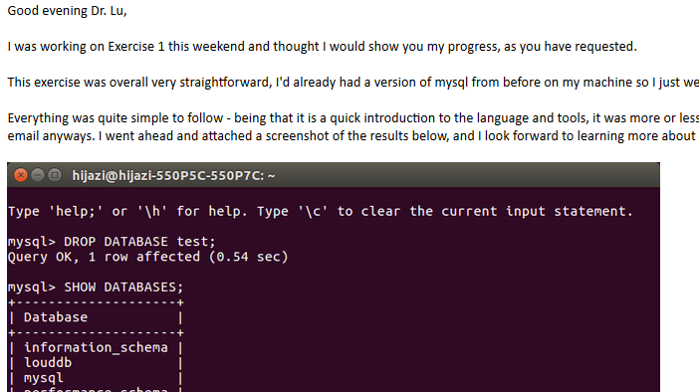
An email from a student

Slide 36
Future Exercises
All future exercises should use the MySQL installed on your PC. So it is critical to understand how to install and run MySQL locally;
All future exercises and course projects will be based on Java, so it is critical to be familiar with Java. If you are not familiar with Java, please talk to me personally.

